Slide 1
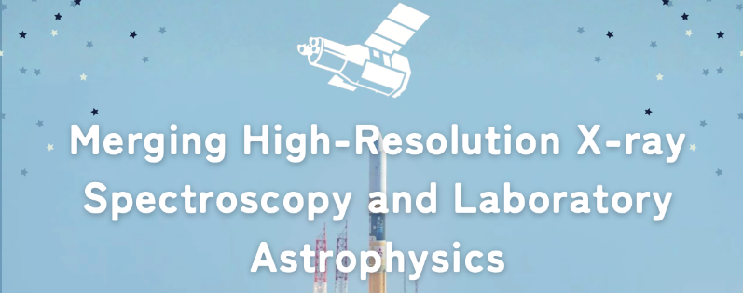
25+5
The Higgs Mode:
Ubiquitous in Superconducting Devices
High energy Accelerator Research Organization (KEK)
Innovation Center for Applied Superconducting Accelerators (iCASA)
Takayuki Kubo
This talk is based on the following 3 papers
T. Kubo, Phys. Rev. Applied 22, 044042 (2024) DOI: https://doi.org/10.1103/PhysRevApplied.22.044042
T. Kubo, Phys. Rev. Applied 23, 054091 (2025) DOI: https://doi.org/10.1103/PhysRevApplied.23.054091
T. Kubo, arXiv:2509.09766 (Published soon in a journal) DOI: https://doi.org/10.48550/arXiv.2509.09766

Slide 2
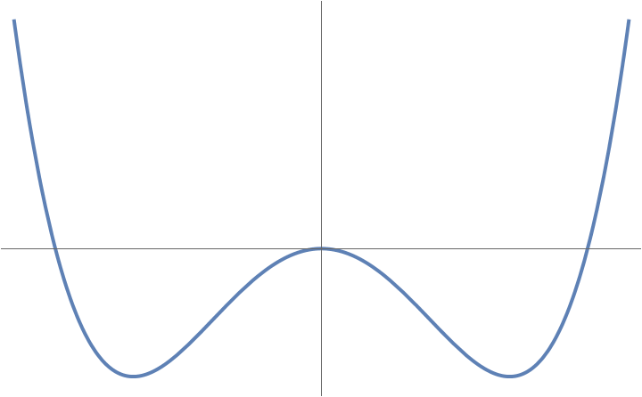
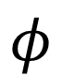

Higgs?
Particle physics
$$φ$$
$$h$$

Slide 3
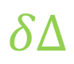
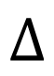
Higgs?
Particle physics
Superconductivity
Oscillation of
superfluid density
$$φ$$
$$Δ$$
$$h$$
$$δΔ$$

Slide 4
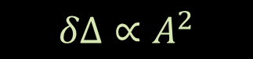
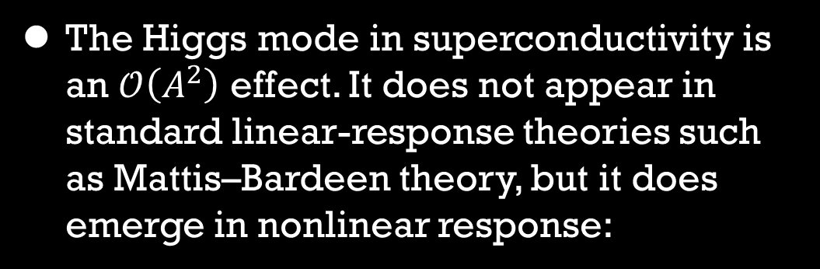
Higgs?
Superconductivity
The Higgs mode in superconductivity is an $𝒪\left(A^{2}\right)$ effect. It does not appear in standard linear-response theories such as Mattis–Bardeen theory, but it does emerge in nonlinear response:
Oscillation of
superfluid density
$$Δ$$
$$δΔ$$
$$δΔ∝A^{2}$$
Nonlinear correction to the current density
$$δJ∼AδΔ∝A^{3}=A_{0}^{3}\cos^{3}{ωt}$$

Slide 5
Higgs?
Superconductivity
The Higgs mode in superconductivity is an $𝒪\left(A^{2}\right)$ effect. It does not appear in standard linear-response theories such as Mattis–Bardeen theory, but it does emerge in nonlinear response:
Oscillation of
superfluid density
$$Δ$$
$$δΔ$$
$$δΔ∝A^{2}$$
Nonlinear correction to the current density
$$δJ∼AδΔ∝A^{3}=A_{0}^{3}\cos^{3}{ωt}$$
$$∼𝒪\left(A_{0}^{3}\right)\cos{ωt}+𝒪\left(A_{0}^{3}\right)\cos{3ωt}$$
↓
First harmonic
↓
Third harmonic

Slide 6
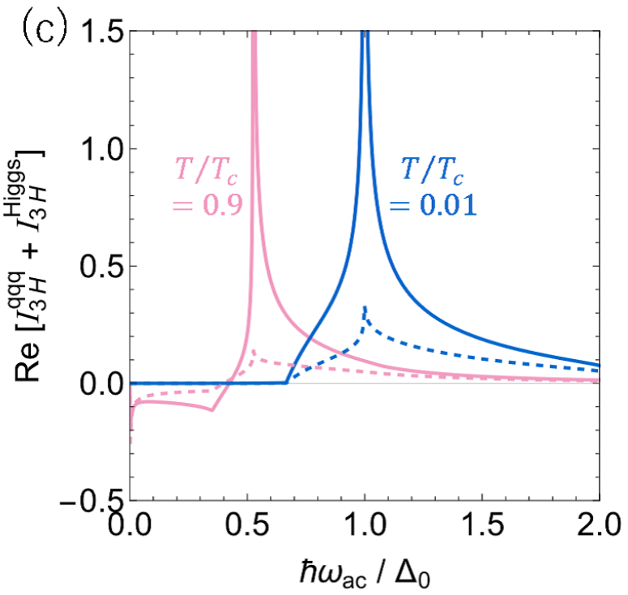
Higgs?
Higgs
resonance
$$δJ∼AδΔ∝A^{3}=A_{0}^{3}\cos^{3}{ωt}$$
$$∼𝒪\left(A_{0}^{3}\right)\cos{ωt}+𝒪\left(A_{0}^{3}\right)\cos{3ωt}$$
↓
First harmonic
↓
Third harmonic
As for the 3rd harmonic response, see also, M. Silaev, Phys. Rev. B 99, 224511 (2019);
P. Derendorf et al., Phys. Rev. B 109, 024510 (2024)
T. Kubo, arXiv:2509.09766 (Published soon in a journal) DOI: https://doi.org/10.48550/arXiv.2509.09766

Slide 7
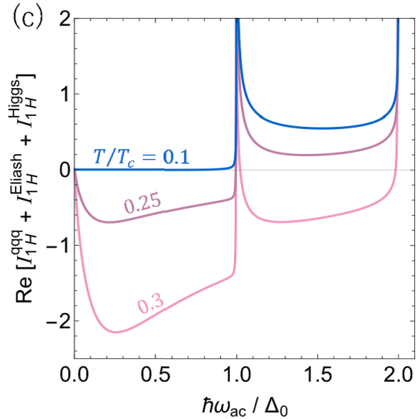
Higgs?
Higgs
resonance
Higgs
resonance
$$δJ∼AδΔ∝A^{3}=A_{0}^{3}\cos^{3}{ωt}$$
$$∼𝒪\left(A_{0}^{3}\right)\cos{ωt}+𝒪\left(A_{0}^{3}\right)\cos{3ωt}$$
↓
First harmonic
↓
Third harmonic
As for the 3rd harmonic response, see also, M. Silaev, Phys. Rev. B 99, 224511 (2019);
P. Derendorf et al., Phys. Rev. B 109, 024510 (2024)
T. Kubo, arXiv:2509.09766 (Published soon in a journal) DOI: https://doi.org/10.48550/arXiv.2509.09766

Slide 8
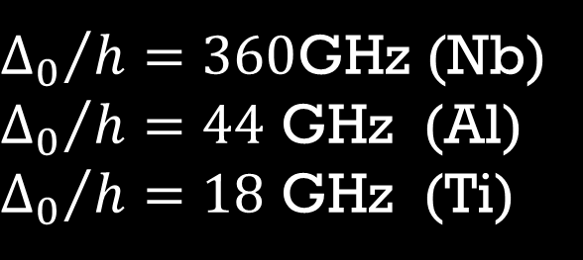
Higgs?
Higgs
resonance
Higgs
resonance
${Δ_{0}}/h=360$GHz (Nb)
${Δ_{0}}/h=44$ GHz (Al)
${Δ_{0}}/h=18$ GHz (Ti)
higher than typical frequencies
of SC devices
Accessible?
As for the 3rd harmonic response, see also, M. Silaev, Phys. Rev. B 99, 224511 (2019);
P. Derendorf et al., Phys. Rev. B 109, 024510 (2024)
T. Kubo, arXiv:2509.09766 (Published soon in a journal) DOI: https://doi.org/10.48550/arXiv.2509.09766

Slide 9
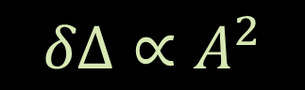
Higgs?
Another way of exciting Higgs mode: dc + ac
A. Moor et al., Phys. Rev. Lett. 118, 047001 (2017)
T. Jujo, J. Phys. Soc. Jpn. 91, 074711 (2022)
T. Kubo, Phys. Rev. Applied 22, 044042 (2024)
T. Kubo, Phys. Rev. Applied 23, 054091 (2025)
$$δΔ∝A^{2}$$
$δΔ∝{\left(A_{dc}+A\right)}^{2}$

Slide 10
Higgs?
Another way of exciting Higgs mode: dc + ac
A. Moor et al., Phys. Rev. Lett. 118, 047001 (2017)
T. Jujo, J. Phys. Soc. Jpn. 91, 074711 (2022)
T. Kubo, Phys. Rev. Applied 22, 044042 (2024)
T. Kubo, Phys. Rev. Applied 23, 054091 (2025)
$$δΔ∝A^{2}$$
$$δΔ∝{\left(A_{dc}+A\right)}^{2}⊃A_{dc}∙A+𝒪(A^{2})$$

Slide 11
Higgs?
Another way of exciting Higgs mode: dc + ac
A. Moor et al., Phys. Rev. Lett. 118, 047001 (2017)
T. Jujo, J. Phys. Soc. Jpn. 91, 074711 (2022)
T. Kubo, Phys. Rev. Applied 22, 044042 (2024)
T. Kubo, Phys. Rev. Applied 23, 054091 (2025)
$$δΔ∝A^{2}$$
$$δΔ∝{\left(A_{dc}+A\right)}^{2}⊃A_{dc}∙A+𝒪(A^{2})$$
↓
Linear
response
↓
Nonlinear
response

Slide 12
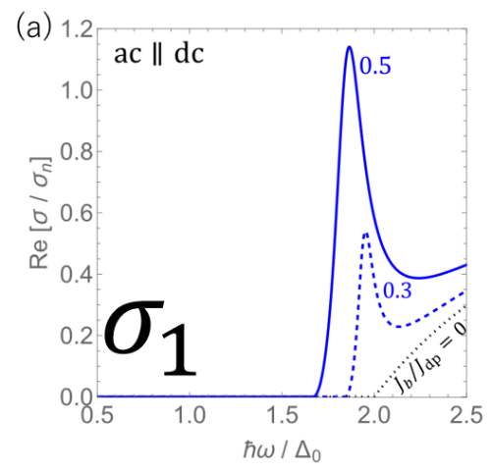
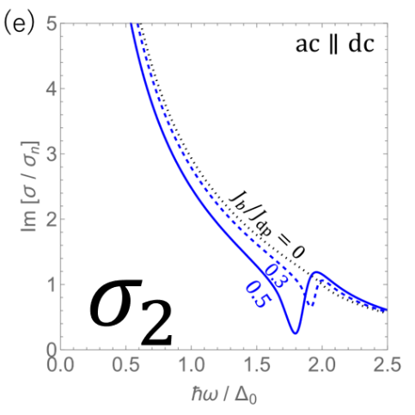
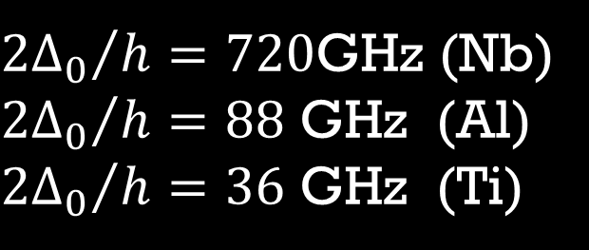
Higgs?
Another way of exciting Higgs mode: dc + ac
A. Moor et al., Phys. Rev. Lett. 118, 047001 (2017)
T. Jujo, J. Phys. Soc. Jpn. 91, 074711 (2022)
T. Kubo, Phys. Rev. Applied 22, 044042 (2024)
T. Kubo, Phys. Rev. Applied 23, 054091 (2025)
$$δΔ∝A^{2}$$
$$δΔ∝{\left(A_{dc}+A\right)}^{2}⊃A_{dc}∙A+𝒪(A^{2})$$
↓
Linear
response
↓
Nonlinear
response
T. Kubo,
Phys. Rev. Applied 23, 054091 (2025)
${2Δ_{0}}/h=720$GHz (Nb)
${{2Δ}_{0}}/h=88$ GHz (Al)
${{2Δ}_{0}}/h=36$ GHz (Ti)

Slide 13
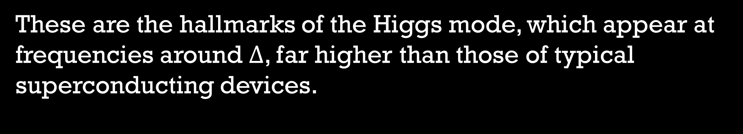
These are the hallmarks of the Higgs mode, which appear at frequencies around $Δ$, far higher than those of typical superconducting devices.

Slide 14
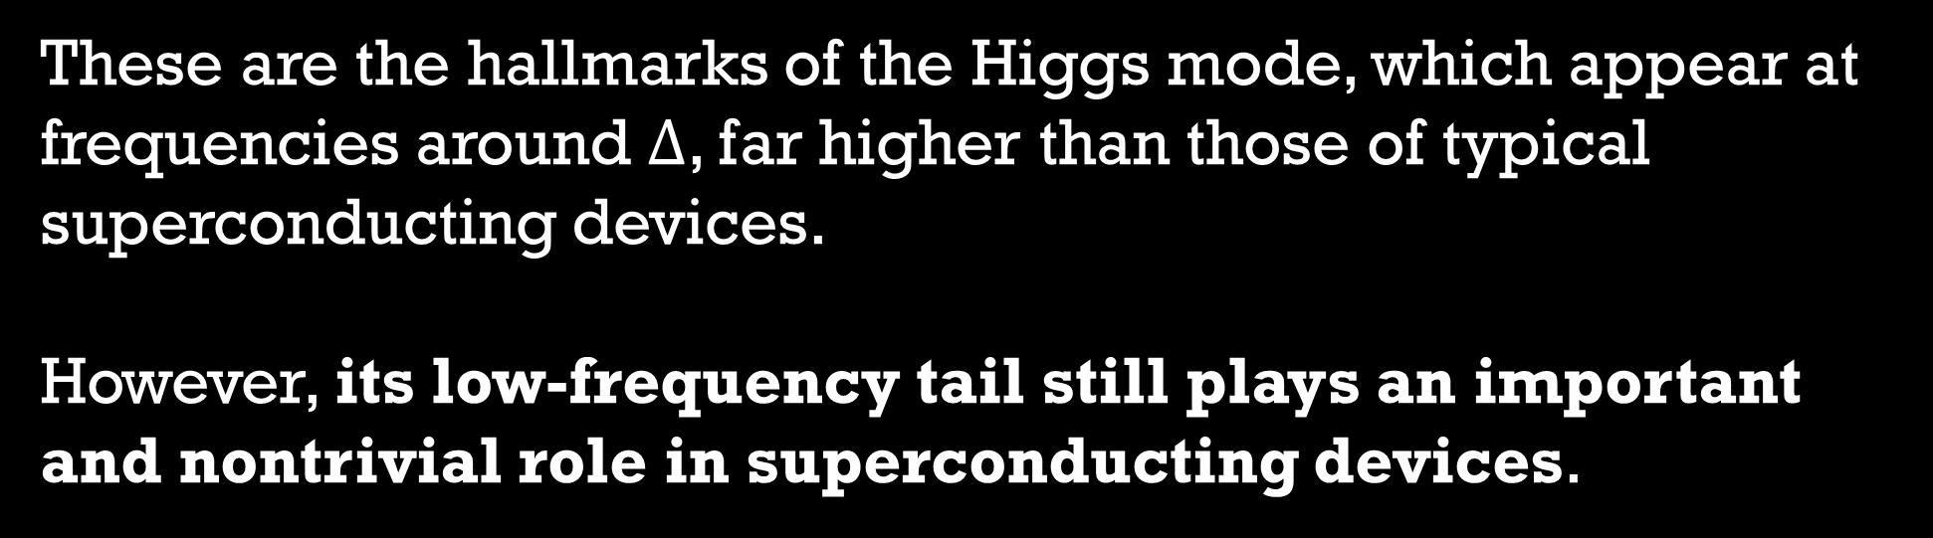
These are the hallmarks of the Higgs mode, which appear at frequencies around $Δ$, far higher than those of typical superconducting devices.
However, its low-frequency tail still plays an important and nontrivial role in superconducting devices.

Slide 15
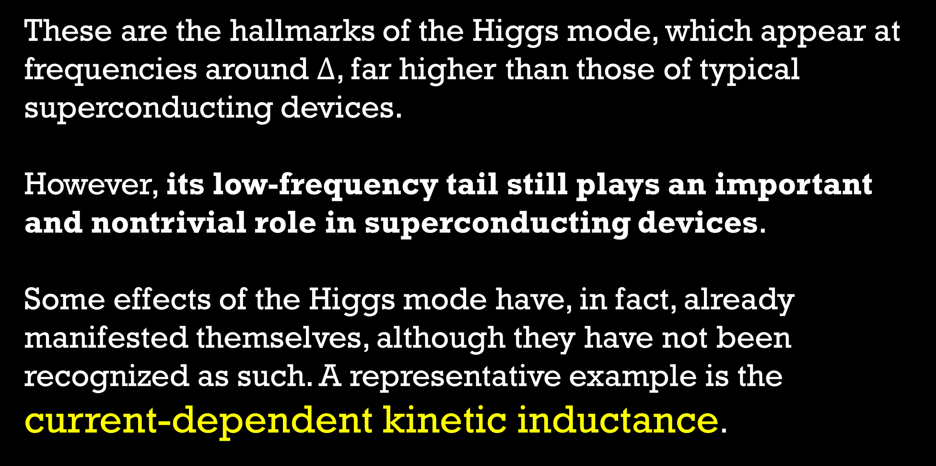
These are the hallmarks of the Higgs mode, which appear at frequencies around $Δ$, far higher than those of typical superconducting devices.
However, its low-frequency tail still plays an important and nontrivial role in superconducting devices.
Some effects of the Higgs mode have, in fact, already manifested themselves, although they have not been recognized as such. A representative example is the current-dependent kinetic inductance.

Slide 16
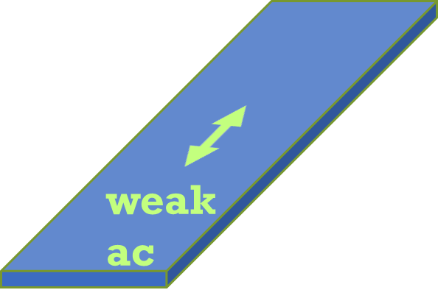
Outline
(1)
Only weak ac

Slide 17
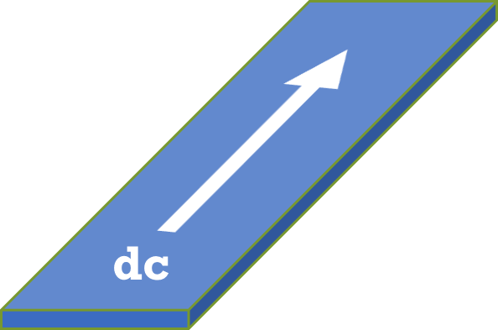
Outline
(1)
Only weak ac
(2)
Only dc current

Slide 18
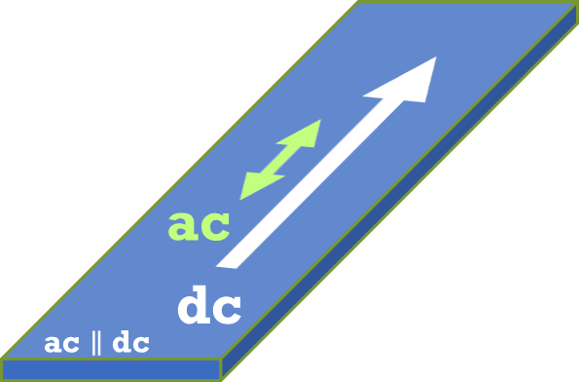
Outline
(1)
(3)
Only weak ac
(2)
ac + dc
Semi-phenomenological
approach
S. M. Anlage et al., IEEE Trans. Magn. 25, 1388 (1989).
J. R. Clem and V. G. Kogan, Phys. Rev. B 86, 174521 (2012).
T. Kubo, Phys. Rev. Research 2, 033203 (2020).
Only dc current

Slide 19
Outline
(1)
(3)
(4)
Only weak ac
(2)
ac + dc
ac + dc
Semi-phenomenological
approach
Microscopic nonequilibrium superconductivity
S. M. Anlage et al., IEEE Trans. Magn. 25, 1388 (1989).
J. R. Clem and V. G. Kogan, Phys. Rev. B 86, 174521 (2012).
T. Kubo, Phys. Rev. Research 2, 033203 (2020).
Only dc current
T. Kubo, Phys. Rev. Applied 22, 044042 (2024)
T. Kubo, Phys. Rev. Applied 23, 054091 (2025)

Slide 20
Outline
(1)
(3)
(4)
Only weak ac
(2)
ac + dc
ac + dc
Semi-phenomenological
approach
Microscopic nonequilibrium superconductivity
S. M. Anlage et al., IEEE Trans. Magn. 25, 1388 (1989).
J. R. Clem and V. G. Kogan, Phys. Rev. B 86, 174521 (2012).
T. Kubo, Phys. Rev. Research 2, 033203 (2020).
Only dc current
T. Kubo, Phys. Rev. Applied 22, 044042 (2024)
T. Kubo, Phys. Rev. Applied 23, 054091 (2025)

Slide 21
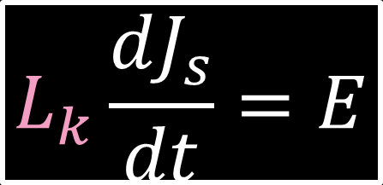
Kinetic inductance under
an AC perturbation (no DC current)
The kinetic inductivity is defined by
$$L_{k}\frac{dJ_{s}}{dt}=E$$
weak
ac

Slide 22
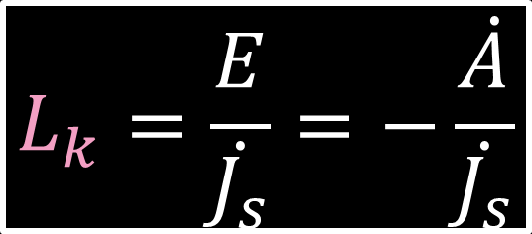
Kinetic inductance under
an AC perturbation (no DC current)
The kinetic inductivity is defined by
$$L_{k}\frac{dJ_{s}}{dt}=E$$
$$L_{k}=\frac{E}{\dot{J_{s}}}=−\frac{\dot{A}}{\dot{J_{s}}}$$
or
weak
ac

Slide 23
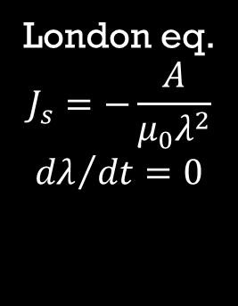
Kinetic inductance under
an AC perturbation (no DC current)
The kinetic inductivity is defined by
$$L_{k}\frac{dJ_{s}}{dt}=E$$
$$L_{k}=\frac{E}{\dot{J_{s}}}=−\frac{\dot{A}}{\dot{J_{s}}}$$
or
weak
ac
London eq.
$$J_{s}=−\frac{A}{μ_{0}λ^{2}}$$
$${dλ}/{dt}=0$$

Slide 24
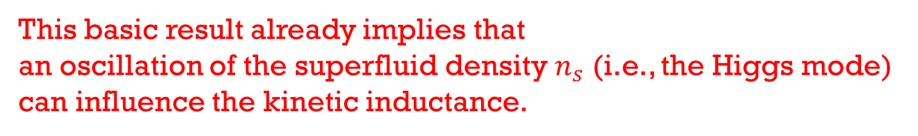

Kinetic inductance under
an AC perturbation (no DC current)
The kinetic inductivity is defined by
$$L_{k}\frac{dJ_{s}}{dt}=E$$
$$L_{k}=\frac{E}{\dot{J_{s}}}=−\frac{\dot{A}}{\dot{J_{s}}}$$
or
weak
ac
London eq.
$$J_{s}=−\frac{A}{μ_{0}λ^{2}}$$
$${dλ}/{dt}=0$$
Very well-known result
$$L_{k}=μ_{0}λ^{2}∝\frac{1}{n_{s}}$$
This basic result already implies that
an oscillation of the superfluid density $n_{s}$ (i.e., the Higgs mode)
can influence the kinetic inductance.

Slide 25
Outline
(1)
(3)
(4)
Only weak ac
(2)
ac + dc
ac + dc
Semi-phenomenological
approach
Microscopic nonequilibrium superconductivity
S. M. Anlage et al., IEEE Trans. Magn. 25, 1388 (1989).
J. R. Clem and V. G. Kogan, Phys. Rev. B 86, 174521 (2012).
T. Kubo, Phys. Rev. Research 2, 033203 (2020).
Only dc current
T. Kubo, Phys. Rev. Applied 22, 044042 (2024)
T. Kubo, Phys. Rev. Applied 23, 054091 (2025)

Slide 26
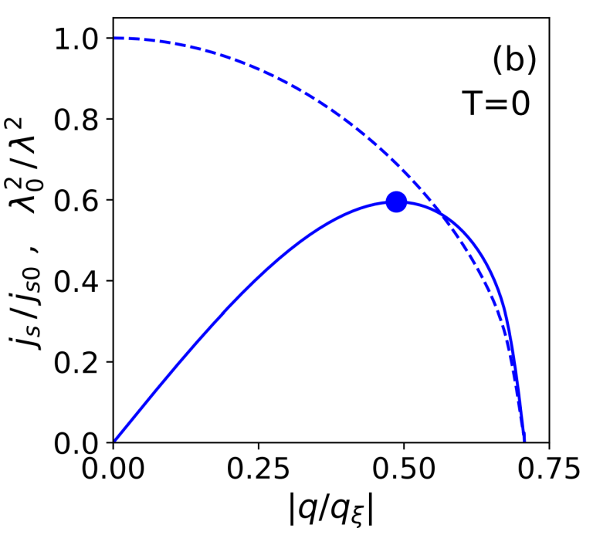
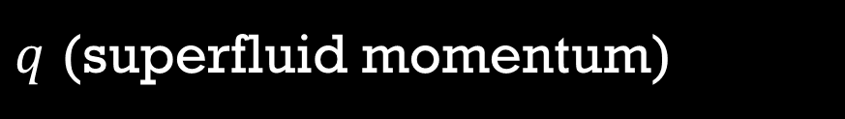
Next, we consider only a dc current.
This case is also well understood from decades ago.
BCS theory
In the dirty limit
$q$ (superfluid momentum)
See, e.g.,
T. Kubo, Phys. Rev. Research 2, 033203 (2020)

Slide 27
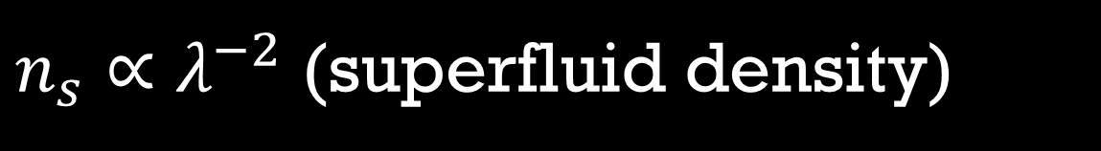
Next, we consider only a dc current.
This case is also well understood from decades ago.
$n_{s}∝λ^{−2}$ (superfluid density)
BCS theory
In the dirty limit
$q$ (superfluid momentum)
See, e.g.,
T. Kubo, Phys. Rev. Research 2, 033203 (2020)

Slide 28
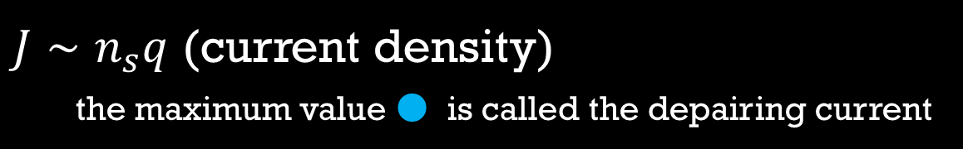
Next, we consider only a dc current.
This case is also well understood from decades ago.
$n_{s}∝λ^{−2}$ (superfluid density)
$J∼n_{s}q$ (current density)
the maximum value ● is called the depairing current
BCS theory
In the dirty limit
$q$ (superfluid momentum)
See, e.g.,
T. Kubo, Phys. Rev. Research 2, 033203 (2020)

Slide 29
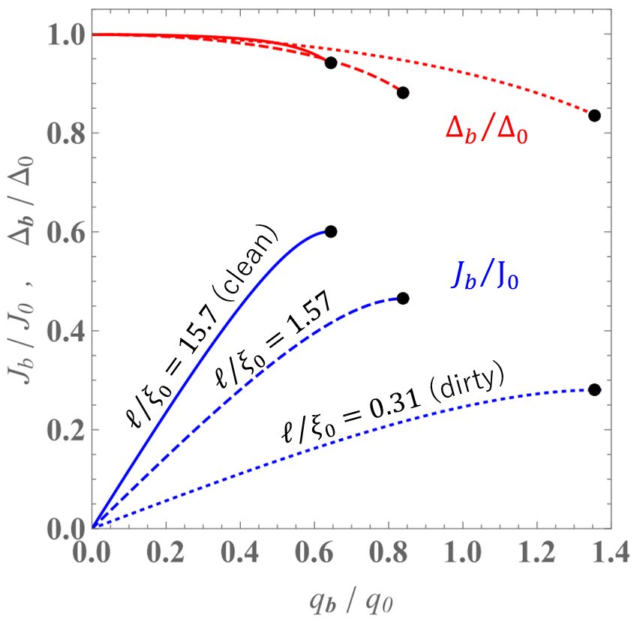
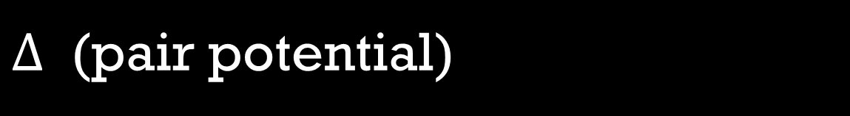
Next, we consider only a dc current.
This case is also well understood from decades ago.
$Δ$ (pair potential)
$J∼n_{s}q$ (current density)
the maximum value ● is called the depairing current
$q$ (superfluid momentum)
T. Kubo, Phys. Rev. Applied 22, 044042 (2024) DOI: https://doi.org/10.1103/PhysRevApplied.22.044042
See also, T. Kubo, Phys. Rev. Research 2, 033203 (2020); F. Pei-Jen Lin and A. Gurevich, Phys. Rev. B 85, 054513 (2012)

Slide 30
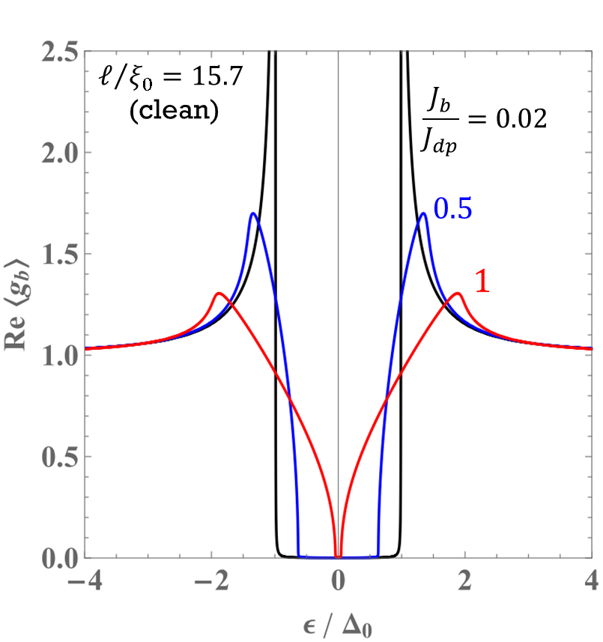
Next, we consider only a dc current.
This case is also well understood from decades ago.
Density
of
States
T. Kubo, Phys. Rev. Applied 22, 044042 (2024) DOI: https://doi.org/10.1103/PhysRevApplied.22.044042
See also, T. Kubo, Phys. Rev. Research 2, 033203 (2020); F. Pei-Jen Lin and A. Gurevich, Phys. Rev. B 85, 054513 (2012)

Slide 31
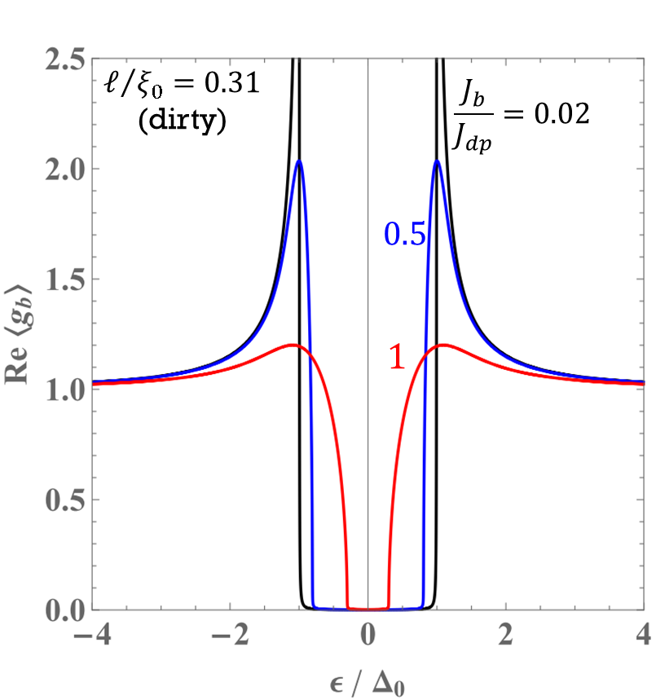
Next, we consider only a dc current.
This case is also well understood from decades ago.
Density
of
States
Density
of
States
T. Kubo, Phys. Rev. Applied 22, 044042 (2024) DOI: https://doi.org/10.1103/PhysRevApplied.22.044042
See also, T. Kubo, Phys. Rev. Research 2, 033203 (2020); F. Pei-Jen Lin and A. Gurevich, Phys. Rev. B 85, 054513 (2012)

Slide 32
Outline
(1)
(3)
(4)
Only weak ac
(2)
ac + dc
ac + dc
Semi-phenomenological
approach
Microscopic nonequilibrium superconductivity
S. M. Anlage et al., IEEE Trans. Magn. 25, 1388 (1989).
J. R. Clem and V. G. Kogan, Phys. Rev. B 86, 174521 (2012).
T. Kubo, Phys. Rev. Research 2, 033203 (2020).
Only dc
T. Kubo, Phys. Rev. Applied 22, 044042 (2024)
T. Kubo, Phys. Rev. Applied 23, 054091 (2025)

Slide 33
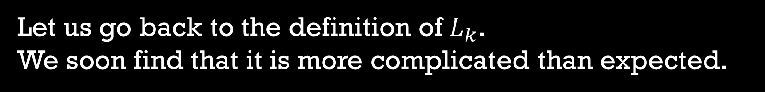
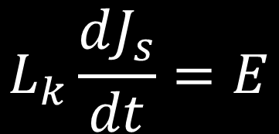
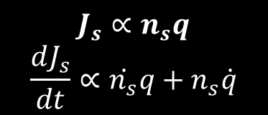
Let us go back to the definition of $L_{k}$​.
We soon find that it is more complicated than expected.
$$L_{k}\frac{dJ_{s}}{dt}=E$$
$$J_{s}∝n_{s}q$$
$$\frac{dJ_{s}}{dt}∝\dot{n_{s}}q+n_{s}\dot{q}$$

Slide 34
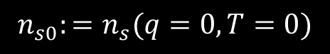

Let us go back to the definition of $L_{k}$​.
We soon find that it is more complicated than expected.
S. M. Anlage et al., IEEE Trans. Magn. 25, 1388 (1989).
J. R. Clem and V. G. Kogan, Phys. Rev. B 86, 174521 (2012).
T. Kubo, Physical Review Research 2, 033203 (2020).
$$L_{k}\frac{dJ_{s}}{dt}=E$$
$$L_{k}=μ_{0}λ_{0}^{2}\frac{\dot{q}}{\dot{\frac{n_{s}}{n_{s0}}}q+\frac{n_{s}}{n_{s0}}\dot{q}}$$
$$J_{s}∝n_{s}q$$
$$\frac{dJ_{s}}{dt}∝\dot{n_{s}}q+n_{s}\dot{q}$$
$$n_{s0}:=n_{s}(q=0,T=0)$$

Slide 35
Let us go back to the definition of $L_{k}$​.
We soon find that it is more complicated than expected.
S. M. Anlage et al., IEEE Trans. Magn. 25, 1388 (1989).
J. R. Clem and V. G. Kogan, Phys. Rev. B 86, 174521 (2012).
T. Kubo, Physical Review Research 2, 033203 (2020).
$$L_{k}\frac{dJ_{s}}{dt}=E$$
$$L_{k}=μ_{0}λ_{0}^{2}\frac{\dot{q}}{\dot{\frac{n_{s}}{n_{s0}}}q+\frac{n_{s}}{n_{s0}}\dot{q}}$$
$$J_{s}∝n_{s}q$$
$$\frac{dJ_{s}}{dt}∝\dot{n_{s}}q+n_{s}\dot{q}$$
This part can be calculated from the equilibrium theory: the BCS theory
$$n_{s0}:=n_{s}(q=0,T=0)$$

Slide 36
Let us go back to the definition of $L_{k}$​.
We soon find that it is more complicated than expected.
S. M. Anlage et al., IEEE Trans. Magn. 25, 1388 (1989).
J. R. Clem and V. G. Kogan, Phys. Rev. B 86, 174521 (2012).
T. Kubo, Physical Review Research 2, 033203 (2020).
$$L_{k}\frac{dJ_{s}}{dt}=E$$
$$L_{k}=μ_{0}λ_{0}^{2}\frac{\dot{q}}{\dot{\frac{n_{s}}{n_{s0}}}q+\frac{n_{s}}{n_{s0}}\dot{q}}$$
$$J_{s}∝n_{s}q$$
$$\frac{dJ_{s}}{dt}∝\dot{n_{s}}q+n_{s}\dot{q}$$
Dynamics of superfluid density!
This part can be calculated from the equilibrium theory: the BCS theory
$$n_{s0}:=n_{s}(q=0,T=0)$$
This looks very much like a nonequilibrium situation.

Slide 37

Semi-phenomenological approach
S. M. Anlage et al., IEEE Trans. Magn. 25, 1388 (1989).
J. R. Clem and V. G. Kogan, Phys. Rev. B 86, 174521 (2012).
T. Kubo, Physical Review Research 2, 033203 (2020).
$$L_{k}=μ_{0}λ_{0}^{2}\frac{\dot{q}}{\dot{\frac{n_{s}}{n_{s0}}}q+\frac{n_{s}}{n_{s0}}\dot{q}}$$
To circumvent the complexity of the nonequilibrium problem,
previous studies introduced the following simplifying assumptions.

Slide 38
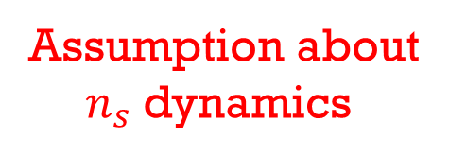
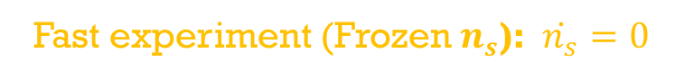

Semi-phenomenological approach
S. M. Anlage et al., IEEE Trans. Magn. 25, 1388 (1989).
J. R. Clem and V. G. Kogan, Phys. Rev. B 86, 174521 (2012).
T. Kubo, Physical Review Research 2, 033203 (2020).
$$L_{k}=μ_{0}λ_{0}^{2}\frac{\dot{q}}{\dot{\frac{n_{s}}{n_{s0}}}q+\frac{n_{s}}{n_{s0}}\dot{q}}$$
To circumvent the complexity of the nonequilibrium problem,
previous studies introduced the following simplifying assumptions.
Assumption about
$n_{s}$ dynamics
Fast experiment (Frozen $n_{s}$): $\dot{n_{s}}=0$
$$L_{k}=μ_{0}λ_{0}^{2}\frac{\dot{q}}{\dot{\frac{n_{s}}{n_{s0}}}q+\frac{n_{s}}{n_{s0}}\dot{q}}→μ_{0}λ_{0}^{2}\frac{1}{\frac{n_{s}(q)}{n_{s0}}}=μ_{0}λ^{2}(q)$$

Slide 39
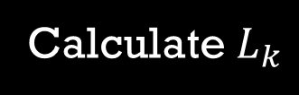
Semi-phenomenological approach
S. M. Anlage et al., IEEE Trans. Magn. 25, 1388 (1989).
J. R. Clem and V. G. Kogan, Phys. Rev. B 86, 174521 (2012).
T. Kubo, Physical Review Research 2, 033203 (2020).
$$L_{k}=μ_{0}λ_{0}^{2}\frac{\dot{q}}{\dot{\frac{n_{s}}{n_{s0}}}q+\frac{n_{s}}{n_{s0}}\dot{q}}$$
To circumvent the complexity of the nonequilibrium problem,
previous studies introduced the following simplifying assumptions.
Assumption about
$n_{s}$ dynamics
Fast experiment (Frozen $n_{s}$): $\dot{n_{s}}=0$
$$L_{k}=μ_{0}λ_{0}^{2}\frac{\dot{q}}{\dot{\frac{n_{s}}{n_{s0}}}q+\frac{n_{s}}{n_{s0}}\dot{q}}→μ_{0}λ_{0}^{2}\frac{1}{\frac{n_{s}(q)}{n_{s0}}}=μ_{0}λ^{2}(q)$$
Calculate $L_{k}$
GL theory
or
BCS theory

Slide 40
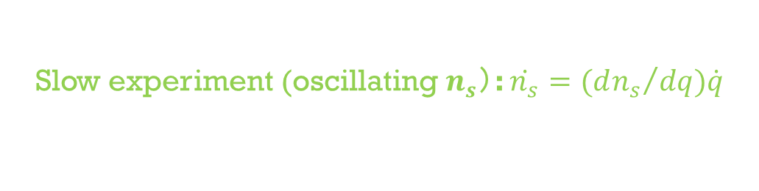


Semi-phenomenological approach
S. M. Anlage et al., IEEE Trans. Magn. 25, 1388 (1989).
J. R. Clem and V. G. Kogan, Phys. Rev. B 86, 174521 (2012).
T. Kubo, Physical Review Research 2, 033203 (2020).
$$L_{k}=μ_{0}λ_{0}^{2}\frac{\dot{q}}{\dot{\frac{n_{s}}{n_{s0}}}q+\frac{n_{s}}{n_{s0}}\dot{q}}$$
To circumvent the complexity of the nonequilibrium problem,
previous studies introduced the following simplifying assumptions.
Assumption about
$n_{s}$ dynamics
Fast experiment (Frozen $n_{s}$): $\dot{n_{s}}=0$
$$L_{k}=μ_{0}λ_{0}^{2}\frac{\dot{q}}{\dot{\frac{n_{s}}{n_{s0}}}q+\frac{n_{s}}{n_{s0}}\dot{q}}→μ_{0}λ_{0}^{2}\frac{1}{\frac{n_{s}(q)}{n_{s0}}}=μ_{0}λ^{2}(q)$$
Calculate $L_{k}$
GL theory
or
BCS theory
Slow experiment (oscillating $n_{s}$）: $\dot{n_{s}}={(dn_{s}}/{dq})\dot{q}$
$$L_{k}=μ_{0}λ_{0}^{2}\frac{\dot{q}}{\dot{\frac{n_{s}}{n_{s0}}}q+\frac{n_{s}}{n_{s0}}\dot{q}}→μ_{0}λ_{0}^{2}\frac{1}{(1+q∂_{q})\frac{n_{s}(q)}{n_{s0}}}$$
Calculate $L_{k}$

Slide 41
We can calculate $L_{k}$​ for any dc bias current.

Slide 42
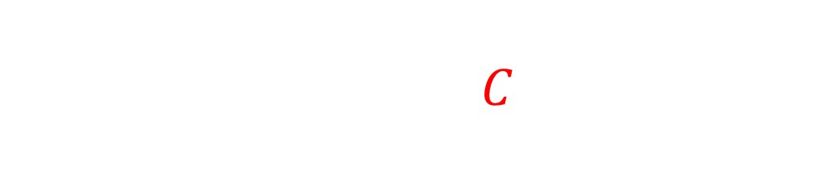
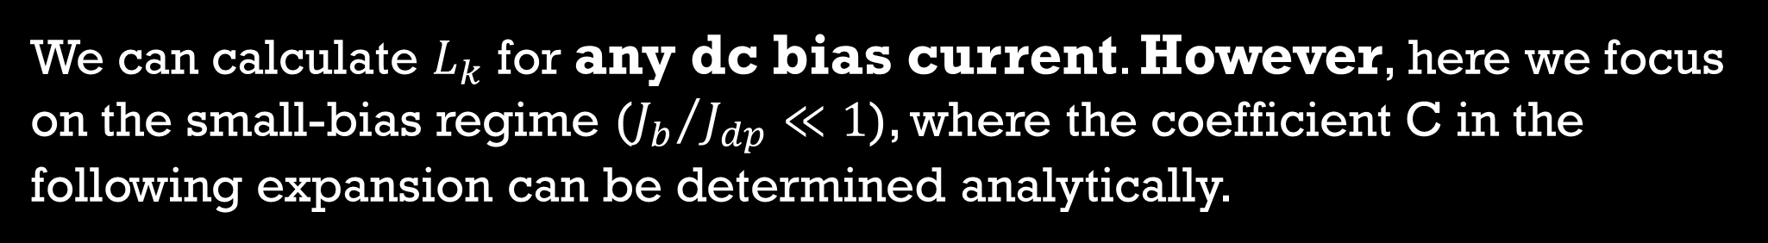
We can calculate $L_{k}$​ for any dc bias current. However, here we focus on the small-bias regime (${J_{b}}/{J_{dp}}≪1$), where the coefficient C in the following expansion can be determined analytically.
$$L_{k}\left(J_{b}\right)=L_{k}(0)\left\{1+C{\left(\frac{J_{b}}{J_{dp}}\right)}^{2}+…\right\}$$

Slide 43
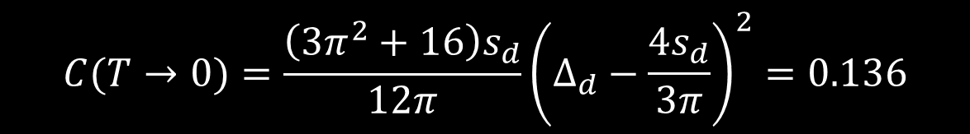
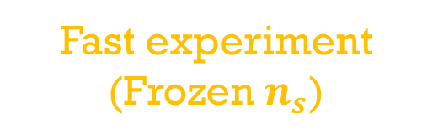
We can calculate $L_{k}$​ for any dc bias current. However, here we focus on the small-bias regime (${J_{b}}/{J_{dp}}≪1$), where the coefficient C in the following expansion can be determined analytically.
$$L_{k}\left(J_{b}\right)=L_{k}(0)\left\{1+C{\left(\frac{J_{b}}{J_{dp}}\right)}^{2}+…\right\}$$
Fast experiment
(Frozen $n_{s}$)
BCS theory in the dirty limit
$$C(T→0)=\frac{\left(3π^{2}+16\right)s_{d}}{12π}{\left(Δ_{d}−\frac{4s_{d}}{3π}\right)}^{2}=0.136$$
T. Kubo, Physical Review Research 2, 033203 (2020).
Physical Review Research 6, 039002 (2024) [Erratum].

Slide 44
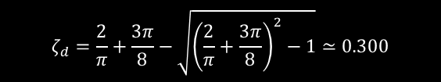
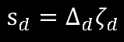
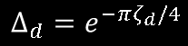
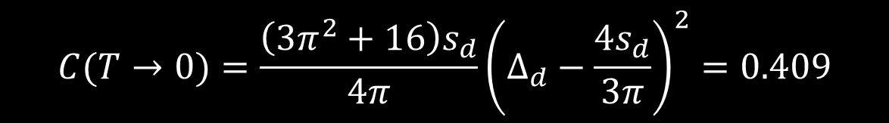
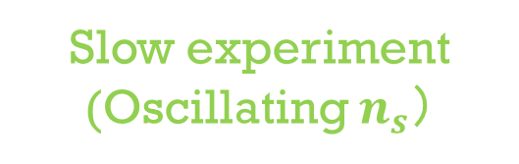
We can calculate $L_{k}$​ for any dc bias current. However, here we focus on the small-bias regime (${J_{b}}/{J_{dp}}≪1$), where the coefficient C in the following expansion can be determined analytically.
$$L_{k}\left(J_{b}\right)=L_{k}(0)\left\{1+C{\left(\frac{J_{b}}{J_{dp}}\right)}^{2}+…\right\}$$
Fast experiment
(Frozen $n_{s}$)
BCS theory in the dirty limit
$$C(T→0)=\frac{\left(3π^{2}+16\right)s_{d}}{12π}{\left(Δ_{d}−\frac{4s_{d}}{3π}\right)}^{2}=0.136$$
$$C(T→0)=\frac{\left(3π^{2}+16\right)s_{d}}{4π}{\left(Δ_{d}−\frac{4s_{d}}{3π}\right)}^{2}=0.409$$
Slow experiment
(Oscillating $n_{s}$）
BCS theory in the dirty limit
$$ζ_{d}=\frac{2}{π}+\frac{3π}{8}−\sqrt{{\left(\frac{2}{π}+\frac{3π}{8}\right)}^{2}−1}≃0.300$$
44
$$Δ_{d}=e^{−πζ_{d}/4}$$
$$s_{d}=Δ_{d}ζ_{d}$$
T. Kubo, Physical Review Research 2, 033203 (2020).
Physical Review Research 6, 039002 (2024) [Erratum].

Slide 45
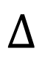



Here, let us recall that
the Higgs mode essentially represents
an oscillation of the superfluid density $n_{s}$​.
Superconductivity
Oscillation of
superfluid density
$$Δ$$
$$δΔ$$
Then,
does the decades-old assumption of “frozen” and “oscillating” $n_{s}$​ correspond to calculations that neglect and include the Higgs-mode effect, respectively?
Does the difference between C=0.136 and C=0.409
arise from the Higgs mode?

Slide 46
Outline
(1)
(3)
(4)
Only weak ac
(2)
ac + dc
ac + dc
Semi-phenomenological
approach
Microscopic nonequilibrium superconductivity
J. R. Clem and V. G. Kogan, Phys. Rev. B 86, 174521 (2012).
T. Kubo, Phys. Rev. Research 2, 033203 (2020).
Only dc
T. Kubo, Phys. Rev. Applied 22, 044042 (2024)
T. Kubo, Phys. Rev. Applied 23, 054091 (2025)

Slide 47


In this case, we need to use the microscopic theory of nonequilibrium superconductivity.
A. Moor et al., Phys. Rev. Lett. 118, 047001 (2017)
T. Jujo, J. Phys. Soc. Jpn. 91, 074711 (2022)
T. Kubo, Phys. Rev. Applied 22, 044042 (2024)
T. Kubo, Phys. Rev. Applied 23, 054091 (2025)
The Keldysh-Eilenberger theory is a microscopic theory of nonequilibrium superconductivity. It is applicable at any temperature ($0≤T≤T_{c}$) and for arbitrary mean free path. In this sense, it serves as the “theory of everything for conventional superconductivity”.
The Keldysh–Usadel theory represents the dirty-limit reduction of the Keldysh–Eilenberger theory of nonequilibrium superconductivity, applicable at any T ($0≤T≤T_{c}$).
T. Kubo, Phys. Rev. Applied 22, 044042 (2024)
T. Kubo, Phys. Rev. Applied 23, 054091 (2025)

Slide 48



Keldysh–Usadel Equation: DC Current with AC Perturbation
T. Kubo, Phys. Rev. Applied 23, 054091 (2025)
Higgs
↓
We solve these equations to obtain the AC-induced nonequilibrium corrections ($δ{\hat{g}}^{R, A, K}$ and $δΔ$).

Slide 49


Keldysh–Usadel Equation: DC Current with AC Perturbation
T. Kubo, Phys. Rev. Applied 23, 054091 (2025)
Higgs
↓
We solve these equations to obtain the AC-induced nonequilibrium corrections ($δ{\hat{g}}^{R, A, K}$ and $δΔ$).
To obtain the ac response,
we substitute the solutions ($δ{\hat{g}}^{R, A, K}$, $δΔ$) into

Slide 50

Instead of showing the rigorous algebraic calculations, we will look at schematic illustrations that represent the final results.
$$J∼Agg+A_{dc}gδg$$

Slide 51


Instead of showing the rigorous algebraic calculations, we will look at schematic illustrations that represent the final results.
$$J∼Agg+A_{dc}gδg$$
$$A$$

Slide 52

Instead of showing the rigorous algebraic calculations, we will look at schematic illustrations that represent the final results.
$$J∼Agg+A_{dc}gδg$$
$δg∼A_{dc}∙A+δΔ$ and $δΔ∼Ψ$ $A_{dc}∙A$
$$A$$

Slide 53








Instead of showing the rigorous algebraic calculations, we will look at schematic illustrations that represent the final results.
$$J∼Agg+A_{dc}gδg$$
$δg∼A_{dc}∙A+δΔ$ and $δΔ∼Ψ$ $A_{dc}∙A$
$$A_{dc}$$
$$A_{dc}$$
$$A_{dc}$$
$$+$$
$$A_{dc}$$
$$A$$
$$Ψ$$
$$A$$
Higgs mediated contribution
$$A$$
AAA cotribution

Slide 54



Instead of showing the rigorous algebraic calculations, we will look at schematic illustrations that represent the final results.
$$J∼Agg+A_{dc}gδg$$
$δg∼A_{dc}∙A+δΔ$ and $δΔ∼Ψ$ $A_{dc}∙A$
$$A_{dc}$$
$$A_{dc}$$
$$A_{dc}$$
$$+$$
$$A_{dc}$$
$$A$$
$$Ψ$$
$$A$$
Higgs mediated contribution
$$A$$
AAA cotribution
$$∝A_{dc}∙A$$
$$∝A_{dc}∙A$$
Nonequilibrium corrections due to the Doppler fluctuation of flow $∝A_{dc}∙A$

Slide 55




Instead of showing the rigorous algebraic calculations, we will look at schematic illustrations that represent the final results.
$$J∼Agg+A_{dc}gδg$$
$δg∼A_{dc}∙A+δΔ$ and $δΔ∼Ψ$ $A_{dc}∙A$
$$A_{dc}$$
$$A_{dc}$$
$$A_{dc}$$
$$+$$
$$A_{dc}$$
$$A$$
$$Ψ$$
$$A$$
Higgs mediated contribution
$$A$$
AAA cotribution
Then, the complex conductivity is given by
$$σ=\frac{J}{E}∼\frac{ + + }{A}$$

Slide 56










Complex conductivity formula
T. Kubo, Phys. Rev. Applied 23, 054091 (2025)
$ac∥dc$ case
$$σ=σ^{(0)}+σ^{(1)}+σ^{(2)}$$
AAA
contribution
$$∝A_{dc}∙A$$
Higgs
mediated contribution
Nonequilibrium corrections due to the Doppler fluctuation of flow $∝A_{dc}∙A$
$$∝A_{dc}∙A$$

Slide 57




Complex conductivity formula
T. Kubo, Phys. Rev. Applied 23, 054091 (2025)
$ac∥dc$ case
$ac⊥dc$ case
$$σ=σ^{(0)}+σ^{(1)}+σ^{(2)}$$
$$σ=σ^{(0)}$$
$$∼$$
AAA
contribution
No Doppler fluctuation
$$∝A_{dc}∙A$$
Higgs
mediated contribution
Nonequilibrium corrections due to the Doppler fluctuation of flow $∝A_{dc}∙A$
$$∝A_{dc}∙A$$

Slide 58



ac $⊥$ dc
T. Kubo,
Phys. Rev. Applied 23, 054091 (2025)

Slide 59

ac $∥$ dc
ac $⊥$ dc
Resonance peak due to the Higgs mode.
Already observed in experiments!
S. Nakamura et al.,
PRL 122, 257001 (2019)
T. Kubo,
Phys. Rev. Applied 23, 054091 (2025)
T. Kubo,
Phys. Rev. Applied 23, 054091 (2025)

Slide 60




To calculate the kinetic inductance, we just go back to its definition.
$$L_{k}\left(J\right)=L_{k}(0)\left\{1+C{\left(\frac{J}{J_{dp}}\right)}^{2}+…\right\}$$
$$L_{k}=\frac{E}{\dot{J_{s}}}$$
$$J_{s}∝e^{−iωt}$$
$$L_{k}=\frac{1}{ωσ_{2}}$$
For $\left(T, ω\right)→(0, 0)$, we can analytically calculate the coefficient C

Slide 61



To calculate the kinetic inductance, we just go back to its definition.
$$L_{k}\left(J\right)=L_{k}(0)\left\{1+C{\left(\frac{J}{J_{dp}}\right)}^{2}+…\right\}$$
$$L_{k}=\frac{E}{\dot{J_{s}}}$$
$$J_{s}∝e^{−iωt}$$
$$L_{k}=\frac{1}{ωσ_{2}}$$
For $\left(T, ω\right)→(0, 0)$, we can analytically calculate the coefficient C
$ac⊥dc$
case
$$C=C^{(0)}≃0.136$$

Slide 62




To calculate the kinetic inductance, we just go back to its definition.
$$L_{k}\left(J\right)=L_{k}(0)\left\{1+C{\left(\frac{J}{J_{dp}}\right)}^{2}+…\right\}$$
$$L_{k}=\frac{E}{\dot{J_{s}}}$$
$$J_{s}∝e^{−iωt}$$
$$L_{k}=\frac{1}{ωσ_{2}}$$
For $\left(T, ω\right)→(0, 0)$, we can analytically calculate the coefficient C
$ac⊥dc$
case
$$C=C^{(0)}≃0.136$$
$ac∥dc$
case
$$C=C^{(0)}+C^{(1)}+C^{(2)}≃0.409$$
AAA
Higgs
$$≃0.136$$
$$≃0.0956$$
$$≃0.177$$
(23%)
(43%)

Slide 63
To calculate the kinetic inductance, we just go back to its definition.
$$L_{k}\left(J\right)=L_{k}(0)\left\{1+C{\left(\frac{J}{J_{dp}}\right)}^{2}+…\right\}$$
$$L_{k}=\frac{E}{\dot{J_{s}}}$$
$$J_{s}∝e^{−iωt}$$
$$L_{k}=\frac{1}{ωσ_{2}}$$
For $\left(T, ω\right)→(0, 0)$, we can analytically calculate the coefficient C
Microscopic theory of
nonequilibrium superconductivity
T. Kubo, Phys. Rev. Applied 22, 044042 (2024)
T. Kubo, Phys. Rev. Applied 23, 054091 (2025)
$ac⊥dc$
case
$$C=C^{(0)}≃0.136$$
$ac∥dc$
case
$$C=C^{(0)}+C^{(1)}+C^{(2)}≃0.409$$
AAA
Higgs
$$≃0.136$$
$$≃0.0956$$
$$≃0.177$$
(23%)
(43%)

Slide 64
To calculate the kinetic inductance, we just go back to its definition.
$$L_{k}\left(J\right)=L_{k}(0)\left\{1+C{\left(\frac{J}{J_{dp}}\right)}^{2}+…\right\}$$
$$L_{k}=\frac{E}{\dot{J_{s}}}$$
$$J_{s}∝e^{−iωt}$$
$$L_{k}=\frac{1}{ωσ_{2}}$$
For $\left(T, ω\right)→(0, 0)$, we can analytically calculate the coefficient C
Microscopic theory of
nonequilibrium superconductivity
Semi-phenomenological
T. Kubo, Phys. Rev. Applied 22, 044042 (2024)
T. Kubo, Phys. Rev. Applied 23, 054091 (2025)
J. R. Clem and V. G. Kogan, Phys. Rev. B 86, 174521 (2012).
T. Kubo, Physical Review Research 2, 033203 (2020).
$ac⊥dc$
case
$$C=C^{(0)}≃0.136$$
$ac∥dc$
case
$$C=C^{(0)}+C^{(1)}+C^{(2)}≃0.409$$
AAA
Higgs
$$≃0.136$$
$$≃0.0956$$
$$≃0.177$$
(23%)
(43%)

Slide 65


To calculate the kinetic inductance, we just go back to its definition.
$$L_{k}\left(J\right)=L_{k}(0)\left\{1+C{\left(\frac{J}{J_{dp}}\right)}^{2}+…\right\}$$
$$L_{k}=\frac{E}{\dot{J_{s}}}$$
$$J_{s}∝e^{−iωt}$$
$$L_{k}=\frac{1}{ωσ_{2}}$$
For $\left(T, ω\right)→(0, 0)$, we can analytically calculate the coefficient C
Microscopic theory of
nonequilibrium superconductivity
Semi-phenomenological
T. Kubo, Phys. Rev. Applied 22, 044042 (2024)
T. Kubo, Phys. Rev. Applied 23, 054091 (2025)
J. R. Clem and V. G. Kogan, Phys. Rev. B 86, 174521 (2012).
T. Kubo, Physical Review Research 2, 033203 (2020).
$ac⊥dc$
case
Fast experiment (Frozen $n_{s}$)
$$C=C^{(0)}≃0.136$$
$$C≃0.136$$
$ac∥dc$
case
$$C=C^{(0)}+C^{(1)}+C^{(2)}≃0.409$$
AAA
Higgs
$$≃0.136$$
$$≃0.0956$$
$$≃0.177$$
(23%)
(43%)

Slide 66


To calculate the kinetic inductance, we just go back to its definition.
$$L_{k}\left(J\right)=L_{k}(0)\left\{1+C{\left(\frac{J}{J_{dp}}\right)}^{2}+…\right\}$$
$$L_{k}=\frac{E}{\dot{J_{s}}}$$
$$J_{s}∝e^{−iωt}$$
$$L_{k}=\frac{1}{ωσ_{2}}$$
For $\left(T, ω\right)→(0, 0)$, we can analytically calculate the coefficient C
Microscopic theory of
nonequilibrium superconductivity
Semi-phenomenological
T. Kubo, Phys. Rev. Applied 22, 044042 (2024)
T. Kubo, Phys. Rev. Applied 23, 054091 (2025)
J. R. Clem and V. G. Kogan, Phys. Rev. B 86, 174521 (2012).
T. Kubo, Physical Review Research 2, 033203 (2020).
$ac⊥dc$
case
Fast experiment (Frozen $n_{s}$)
$$C=C^{(0)}≃0.136$$
$$C≃0.136$$
$ac∥dc$
case
Slow experiment (Oscillating $n_{s}$）
$$C=C^{(0)}+C^{(1)}+C^{(2)}≃0.409$$
$$C≃0.409$$
AAA
Higgs
$$≃0.136$$
$$≃0.0956$$
$$≃0.177$$
(23%)
(43%)

Slide 67









“C” from the Keldysh-Eilenberger theory, which is a microscopic theory of nonequilibrium superconductivity and is applicable at any temperature ($0≤T≤T_{c}$) and for arbitrary mean free path.
$$L_{k}\left(J_{b}\right)=L_{k}(0)\left\{1+C{\left(\frac{J_{b}}{J_{dp}}\right)}^{2}+…\right\}$$
$$C≃0.4$$
$$ac∥dc$$
Consistent with the dirty limit result
obtained from the Keldysh-Usadel
$$C≃0.14$$
$$ac⊥dc$$

Slide 68


We have finally come to understand the true meaning of the semi-phenomenological approach: frozen and oscillating $n_{s}$
[When Does it happen?]
What has long been believed
The ac frequency is so fast that
the superfluid density cannot follow it.
(Fast experiment)
Frozen $n_{s}$

Slide 69

We have finally come to understand the true meaning of the semi-phenomenological approach: frozen and oscillating $n_{s}$
[When Does it happen?]
What has long been believed
The ac frequency is so fast that
the superfluid density cannot follow it.
(Fast experiment)
Frozen $n_{s}$
Oscillating $n_{s}$
The ac frequency is so slow that the superfluid density can follow it.
(Slow experiment)

Slide 70
We have finally come to understand the true meaning of the semi-phenomenological approach: frozen and oscillating $n_{s}$
[When Does it happen?]
[When Does it happen?]
What has been revealed
by the microscopic theory of nonequilibrum superconductivity
What has long been believed
The ac frequency is so fast that
the superfluid density cannot follow it.
(Fast experiment)
Frozen $n_{s}$
Oscillating $n_{s}$
The ac frequency is so slow that the superfluid density can follow it.
(Slow experiment)

Slide 71


We have finally come to understand the true meaning of the semi-phenomenological approach: frozen and oscillating $n_{s}$
[When Does it happen?]
[When Does it happen?]
What has been revealed
by the microscopic theory of nonequilibrum superconductivity
What has long been believed
The ac frequency is so fast that
the superfluid density cannot follow it.
(Fast experiment)
Frozen $n_{s}$
$$ac⊥dc$$
Oscillating $n_{s}$
The ac frequency is so slow that the superfluid density can follow it.
(Slow experiment)
$$ac∥dc$$
(AAA and Higgs contribution)
wrong

Slide 72







Summary
The Higgs mode is ubiquitous in superconducting devices. The current dependence of the kinetic inductance is a representative example.
$$L_{k}\left(J\right)=L_{k}(0)\left\{1+C{\left(\frac{J}{J_{dp}}\right)}^{2}+…\right\}$$
$ac⊥dc$
case
$$C=C^{(0)}≃0.136$$
$ac∥dc$
case
$$C=C^{(0)}+C^{(1)}+C^{(2)}≃0.409$$
AAA
Higgs
$$≃0.136$$
$$≃0.0956$$
$$≃0.177$$
(23%)
(43%)

Slide 73


Slide 74


Other works of mine that may interest you:
T. Kubo, On the applicability ranges of Tc formulas for proximity-coupled thin SN and SS bilayers, Japanese Journal of Applied Physics 64, 018001 (2025).
This is a brief review of Tc formulas of SN and SS bilayers. Because several distinct formulas exist, misuse is common. Please verify that your choice is appropriate. For instance, if a chosen formula yields a Tc that increases with the N-layer thickness, that formula is being applied outside its valid range. The solution is here.
T. Takenaka, T. Kubo et al., Three-Dimensional Niobium Coaxial Cavity with ~0.1 second Lifetime, arXiv:2510.01819.
In this work, we applied surface-treatment technologies developed for accelerator cavities and achieved a world-record quality factor in this type of quantum-memory cavity for quantum computing applications.
Tc
If you encounter this problem,
you’re using the wrong formula!
wrong
correct
N thickness
←cavity
Me
↓

Slide 75

Backup ($σ_{1}$)

Slide 76






Analogue R_{s}(E) curve
in ac+dc system
$${ℏω}/{Δ_{0}}=0.02$$
$$0.04$$
$$0.1$$
dc: arbitrary strength
ac: perturbation
$ℓ/{ξ_{0}}=0.31$ (dirty)
$$T/{T_{c}}=0.217$$
T. Kubo, Phys. Rev. Applied 22, 044042 (2024)

Slide 77

Let’s see the orange curves (${ℏω}/{Δ_{0}}=0.02$),which correspond to 7GHz for Nb.
7GHz for Nb
$${ℏω}/{Δ_{0}}=0.02$$
$$0.04$$
$$0.1$$
$ℓ/{ξ_{0}}=0.31$ (dirty)
$$T/{T_{c}}=0.217$$
T. Kubo, Phys. Rev. Applied 22, 044042 (2024)

Slide 78

Let’s see the orange curves (${ℏω}/{Δ_{0}}=0.02$),which correspond to 7GHz for Nb.
$${ℏω}/{Δ_{0}}=0.02$$
Dotted curve:
$$Re[σ^{\left(0\right)}]$$
$$0.04$$
$$0.1$$
$ℓ/{ξ_{0}}=0.31$ (dirty)
$$T/{T_{c}}=0.217$$
T. Kubo, Phys. Rev. Applied 22, 044042 (2024)

Slide 79


Let’s see the orange curves (${ℏω}/{Δ_{0}}=0.02$),which correspond to 7GHz for Nb.
$${ℏω}/{Δ_{0}}=0.02$$
Dotted curve:
$$Re[σ^{\left(0\right)}]$$
$$0.04$$
$$0.1$$
Dashed curve:
Re[$σ^{(0)}+σ^{(1)}]$
$ℓ/{ξ_{0}}=0.31$ (dirty)
$$T/{T_{c}}=0.217$$
Significant contribution from
the direct AAA action term $σ^{(1)}$
T. Kubo, Phys. Rev. Applied 22, 044042 (2024)

Slide 80

Let’s see the orange curves (${ℏω}/{Δ_{0}}=0.02$),which correspond to 7GHz for Nb.
$${ℏω}/{Δ_{0}}=0.02$$
Dotted curve:
$$Re[σ^{\left(0\right)}]$$
$$0.04$$
$$0.1$$
Dashed curve:
Re[$σ^{(0)}+σ^{(1)}]$
Solid curve:
Re[$σ^{(0)}+σ^{(1)}+σ^{(2)}]$
$ℓ/{ξ_{0}}=0.31$ (dirty)
$$T/{T_{c}}=0.217$$
Significant contribution from
the direct AAA action term $σ^{(1)}$
T. Kubo, Phys. Rev. Applied 22, 044042 (2024)

Slide 81











The analogue anti Q-slope is pronounced as the frequency increases
1.8 GHz for Nb
3.6 GHz for Nb
14 GHz for Nb
$${ℏω}/{Δ_{0}}=0.005$$
$$0.2$$
$$0.01$$
7 GHz for Nb
$$0.02$$
$$0.04$$
The key player is the direct AAA photon action
36 GHz for Nb
$$0.1$$
$$σ=σ^{(0)}+σ^{(1)}+σ^{(2)}$$
$ℓ/{ξ_{0}}=0.31$ (dirty)
$$T/{T_{c}}=0.217$$
Big clue to understand the pronounced anti Q-slope with increasing frequency
T. Kubo, Phys. Rev. Applied 22, 044042 (2024)

